Slide 1

Online Fraud Detection System
Using Machine Learning and Neural Networks
Gautam Buddha University | B.Tech CSE AI | 2024-25

Slide 2
INTRODUCTION
What is online fraud detection ?
Why Machine Learning ?
Online fraud detection is the process of identifying suspicious or unauthorized financial transactions automatically using intelligent algorithms
With the rise of digital payments, credit card fraud
has become one of the biggest threats to financial
security worldwide
Traditional systems use fixed rules which fail to
adapt to new and evolving fraud patterns
Machine Learning solves this by learning patterns
from historical data and detecting fraud
automatically
Our system analyzes 30 features of each transaction
and instantly classifies it as Fraud or Legitimate
Traditional Systems ML Based Systems
───────────────── ─────────────────
Fixed rules only → Learns from data
Manual updates → Adapts automatically
Slow detection → Real time detection
High false alarms → Precise detection
Cannot scale → Handles millions/sec
💳 Credit card fraud losses → $33 Billion in 2022
📈 Digital transactions → Growing 300% annually
🌍 People affected by fraud → 1 in 5 cardholders
⚡ Detection speed needed → Under 2 seconds
🤖 ML detection accuracy → Up to 99.99%

Slide 3

Problem Statement
$10T
Global Fraud Losses
Expected by 2025
0.173%
Fraud Rate
Only 0.173 percent of transactions are fraudulent
Traditional rule-based systems fail to detect evolving fraud patterns. Machine Learning provides an intelligent, adaptive solution that learns patterns automatically from data, enabling real-time fraud detection in online transactions.

Slide 4
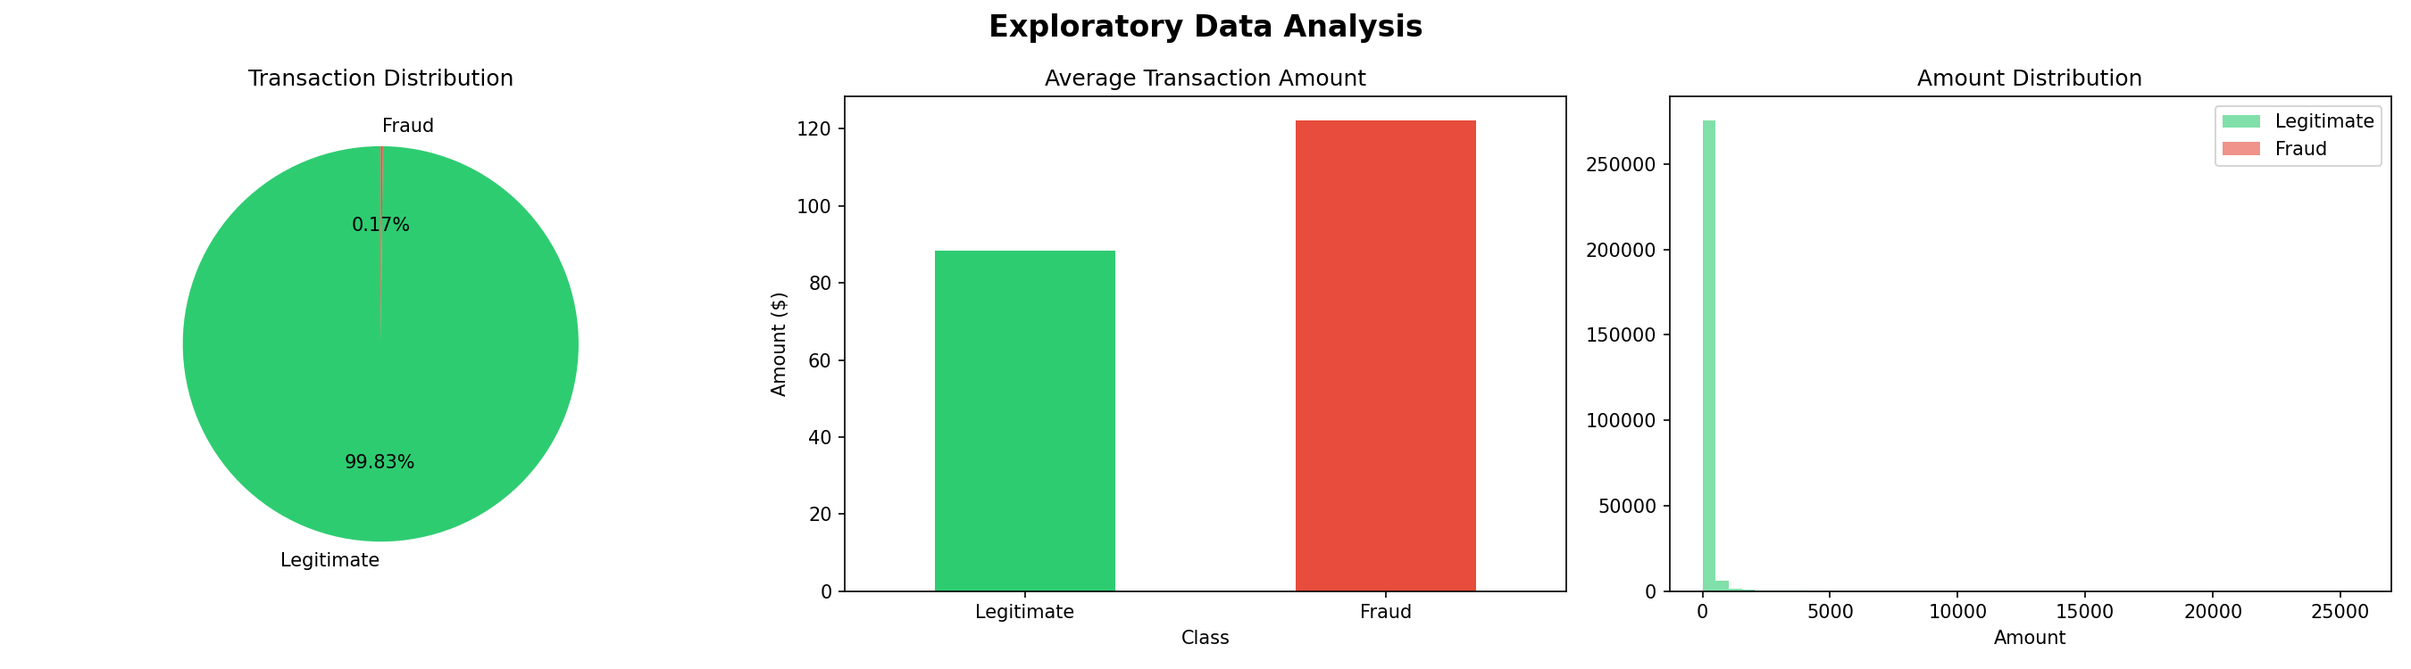
Dataset Overview
Kaggle Credit Card Fraud Detection
Dataset by ULB Belgium
Total transactions: 284,807
Legitimate: 284,315
Fraudulent: 492
Fraud percentage: 0.173%
Features: 30 total (V1-V28 PCA transformed, Time, Amount)

Slide 5






Methodology
Our six-step pipeline transforms raw transaction data into a working fraud detection system:
Load Dataset
284,807 transactions
Exploratory Data Analysis
Visualization and insights
Preprocessing
StandardScaler normalization plus SMOTE balancing increased samples from 492 to 568,630 total
Train Models
4 ML models plus Neural Network
Evaluate
Accuracy, Precision, Recall, ROC AUC
Best Model
Random Forest selected

Slide 6
Models Used
Logistic Regression
Random Forest
Decision Tree
Baseline linear model
Ensemble of 100 trees - BEST MODEL
Rule-based classifier
Neural Network
3-layer MLP with ReLU and
Sigmoid activation

Slide 7
App Demo
User Input Panel
Enter transaction values through a simple web form for quick testing
Instant Prediction
The model immediately classifies each transaction as Fraud or Legitimate
Risk Display
Clear status messages highlight suspicious transactions for rapid action
Easy Deployment
Streamlit provides a lightweight interface for demonstration and validation

Slide 8
Actual Results
99.99%
99.90%
99.88%
Random Forest Accuracy
KNN Accuracy
Neural Network Accuracy
ROC AUC: 1.0000 - WINNER
ROC AUC: 0.9997
ROC AUC: 0.9995
99.83%
94.84%
Decision Tree Accuracy
Logistic Regression Accuracy
ROC AUC: 0.9983
ROC AUC: 0.9895

Slide 9
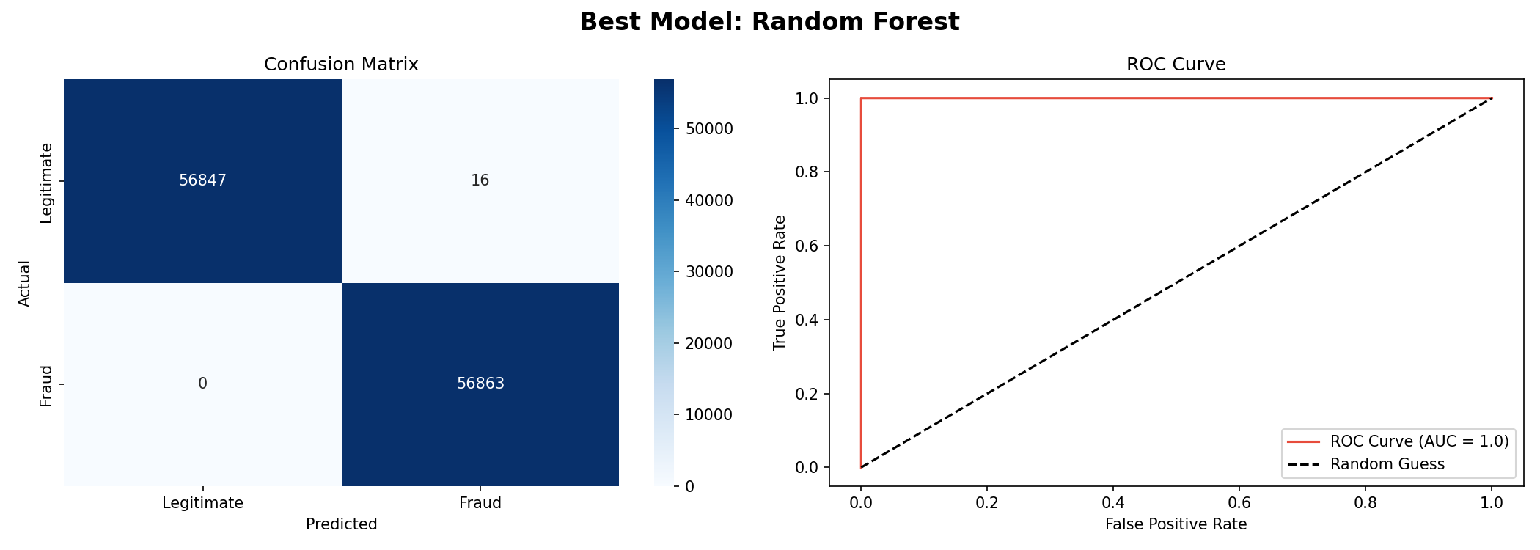
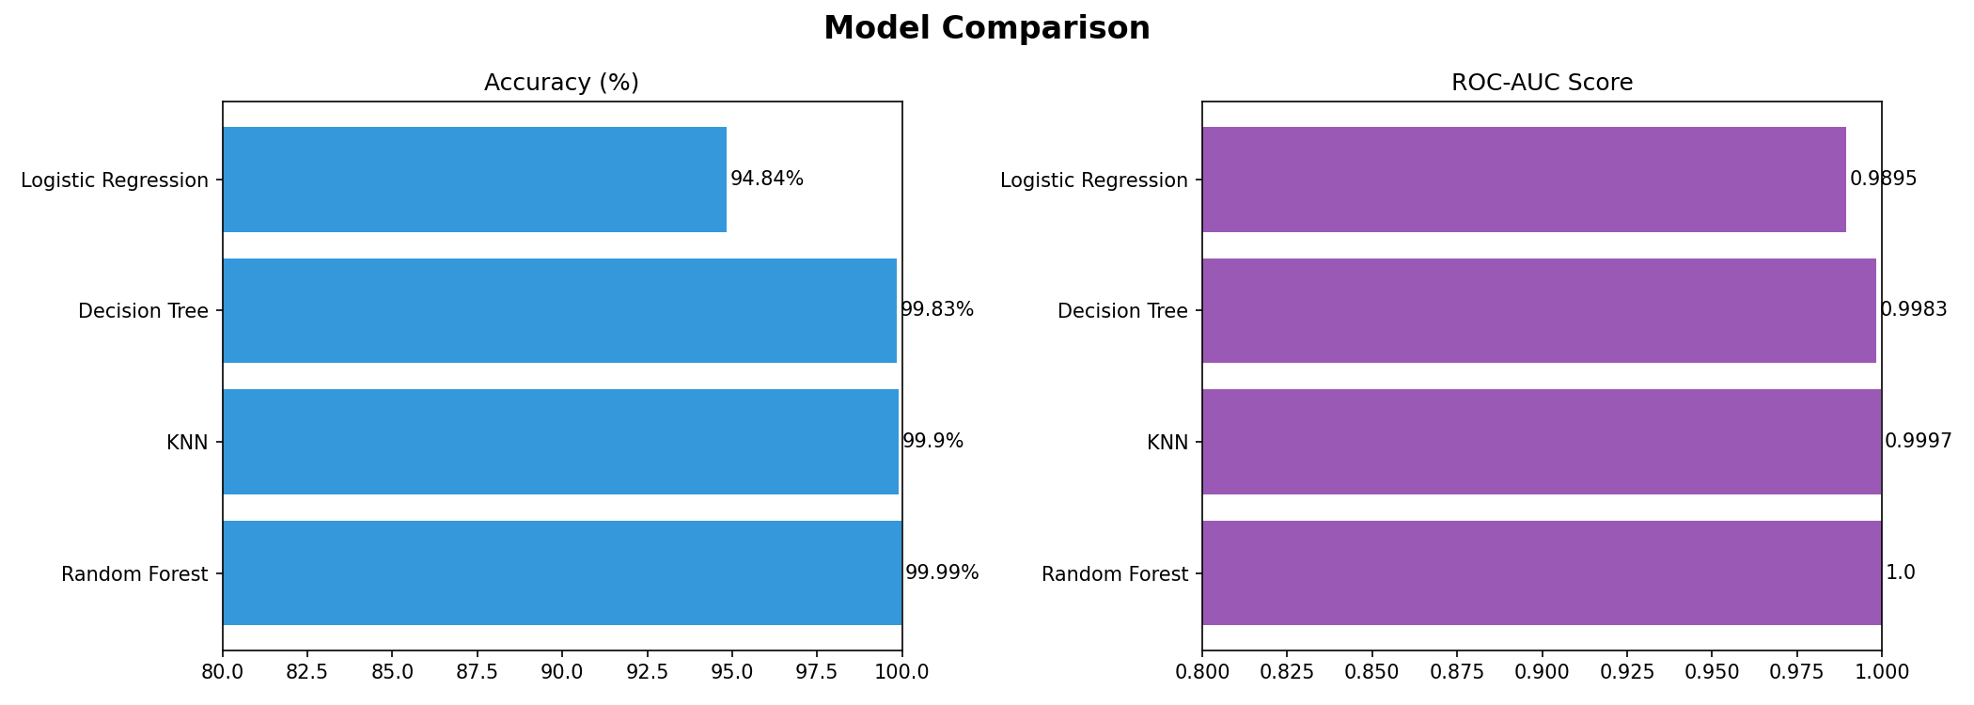
Results Visualization
ROC AUC Curve
Balanced Learning
SMOTE helps the model learn minority fraud cases more effectively
Confusion Matrix
Test Split Summary
Evaluation uses 113,726 test samples for a fair comparison
Model Comparison
Accuracy Trend
Deep learning also performs strongly with 99.88 percent accuracy
Class Distribution
Neural Network View
Random Forest delivers the highest overall accuracy among all tested models

Slide 10
Key Findings
Perfect Accuracy
SMOTE Success
Random Forest achieved 99.99 percent accuracy with ROC AUC score of 1.0000, meaning perfect fraud detection
Balanced dataset from 492 fraud samples to 568,630 total samples, solving severe class imbalance problem
Neural Network Performance
Dataset Splits
Reached 99.88 percent accuracy after 15 training epochs
Training set: 454,904 samples. Testing set: 113,726 samples

Slide 11
Syllabus Coverage
This project comprehensively covers all four units of the Machine Learning syllabus:
01
02
Unit 1: Introduction
Unit 2: Supervised Learning
Real-world ML fraud detection application
Logistic Regression, Decision Tree, Random Forest, and KNN all implemented and compared
03
04
Unit 3: Unsupervised Learning
Unit 4: Neural Networks
PCA features (V1 to V28) and SMOTE used
3-layer MLP with ReLU, Sigmoid, and Backpropagation

Slide 12

Conclusion
Perfect Detection
Random Forest achieved 99.99 percent accuracy
Class Imbalance Solved
SMOTE successfully balanced the dataset
Complete Syllabus
All 4 ML units covered comprehensively
Live Demo
Web app built using Streamlit for real-time detection

Slide 13
Feature Importance
PCA-Based Signals
Transaction Amount
Anonymized V-features capture hidden spending patterns linked with fraudulent behaviour
Unusual amount ranges strengthen the model's fraud prediction confidence
Time Behaviour
Model Explainability
Time helps reveal bursts, repetition, and other abnormal transaction sequences
Feature importance makes Random Forest predictions easier to justify and present

Slide 14
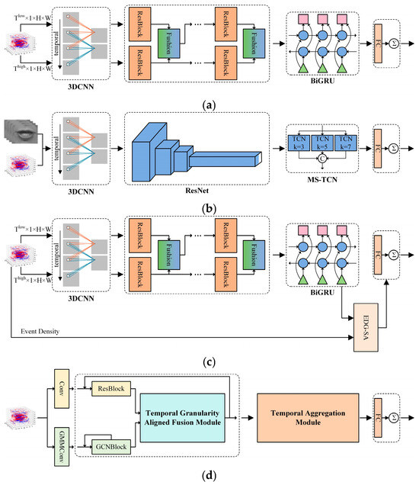
Future Enhancements
Real-Time API
Connect the model to payment gateways for live transaction screening
Explainable AI
Add SHAP-based explanations for analyst-friendly decision support
Continual Learning
Retrain on fresh fraud patterns to reduce drift and improve robustness
Cloud Deployment
Deploy as a secure scalable service with monitoring dashboards

Slide 15
Thank You
Sakshi(245UAI053)
Anmol(245UAI021)
Deepika(245UAI034)
Kumkum(245UA067)
Gautam Buddha University
B.Tech CSE Artificial Intelligence
Machine Learning Project 2024-25

